Slide 1

ANDROID TV BOX APP

Slide 2
DEVELOPMENT ENVIRONMENT

Slide 3

FRAMEWORK
Flutter
- Is an open-source framework by Google .
- Multi-platform.
- Uses the open-source programming language Dart.

Slide 4

PROGRAMMING LANGUAGE
Dart
- Is a client-optimized language.
- Offer the most productive programming language for multi-platform development.

Slide 5
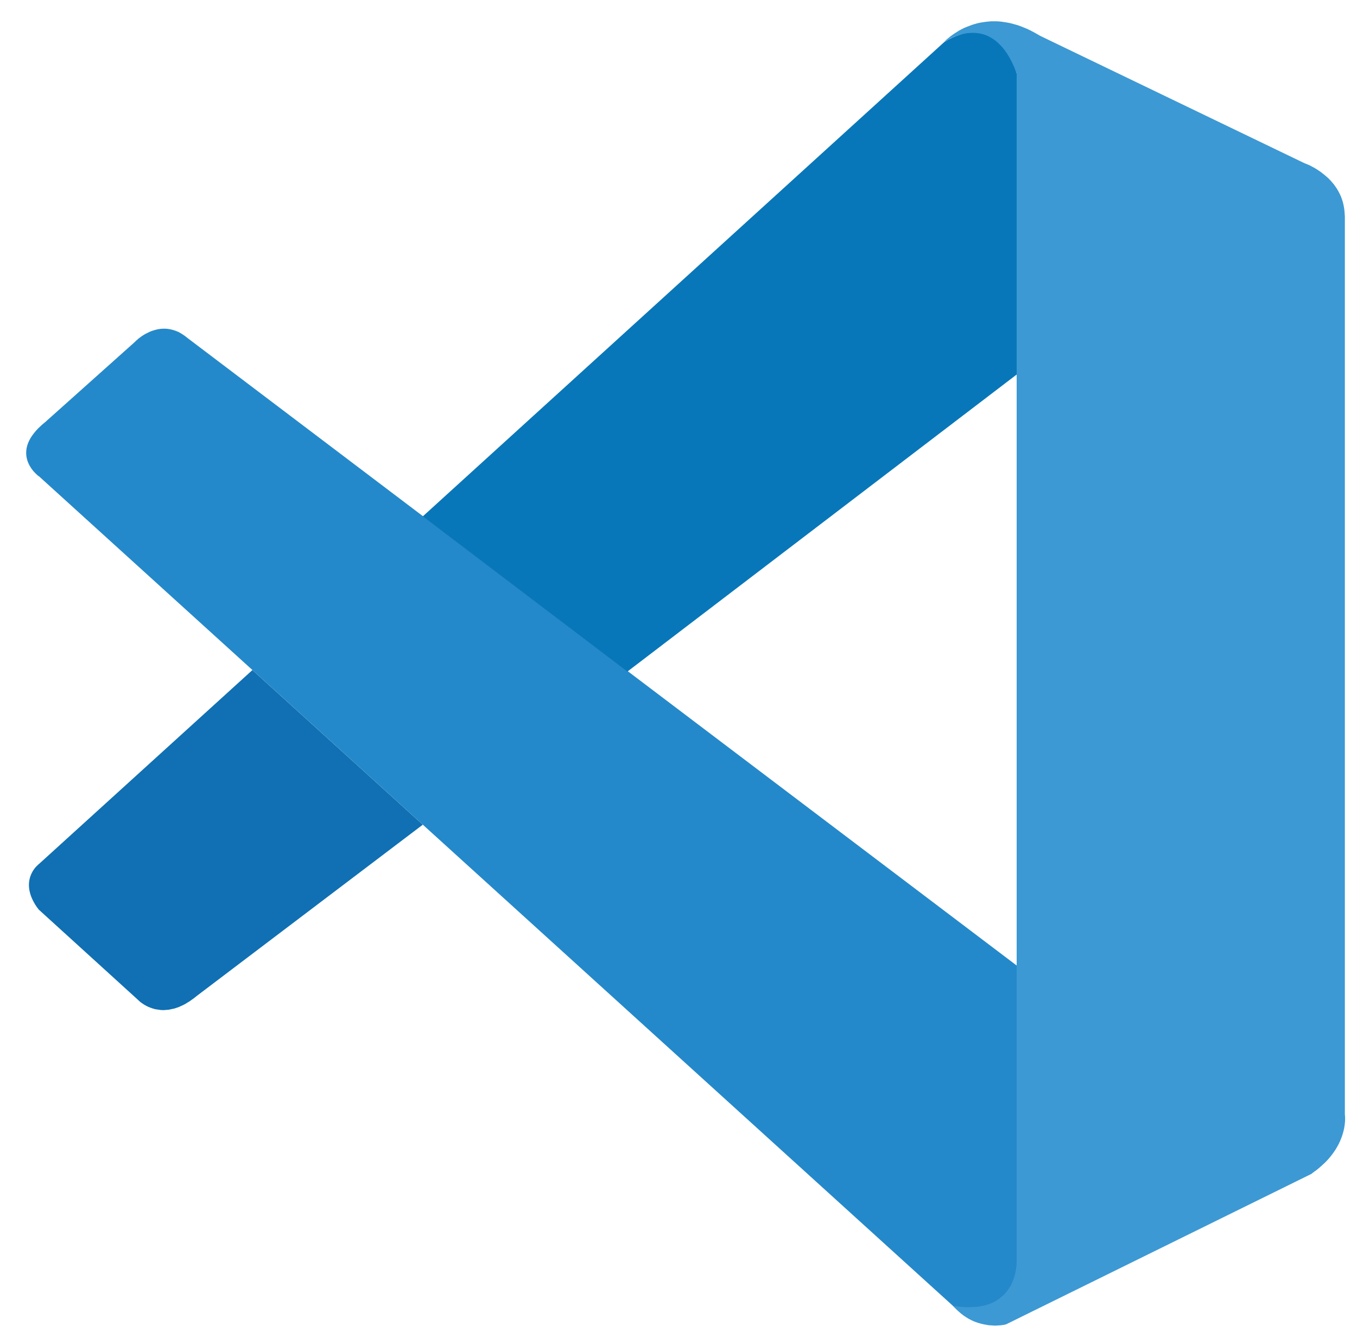
IDE
Visual Studio Code
- It is a free, open-source code editor developed by Microsoft.

Slide 6
MODULES

Slide 7
VIDEO
- Live TV / Free-to-Air Channels
- Broadcast LGU latest news, live broadcast of events like flag raisings, as well as live streams in case of pre-disaster information.

Slide 8
ANNOUNCEMENT
LGU Community Announcements
Disaster Warnings

Slide 9
EVENT
LGU Community Events

Slide 10
GAME
- Daily Luck Spin (or any game) offers to upgrade free internet speeds.
- Games are different every day and randomized each week (Tentative).

Slide 11
NOTIFICATION
- Display the notifications to the users such as notification for chance to upgrade their internet speed.

Slide 12
PROTOTYPE

